Slide 1


PYTHON LIBRARY MANAGEMENT DATABASE SYSTEM
PYTHON FOR COMPUTATIONAL PROBLEM SOLVING UE23CS151A MINI PROJECT 2023
Done By:
NIKHIL BHAKTHA: PES1UG23EC202
RISHITH SAHU: PES1UG23CS481
Under Guidance of:
Prof. C. N. Rajeshwari
Department of CSE
PES University

Slide 2
PROJECT DESCRIPTION
Creating a library management system having:
Book master information
Student master information
Book issuance module
Book return module
Graphical User Interface

Slide 3
DESIGN OF THE PROJECT
Created Modules:
Home Page
Book master maintenance module
Student master maintenance module
Book issuance module
Book return module
Predefined modules:
SQLite3
Tkinter GUI

Slide 4
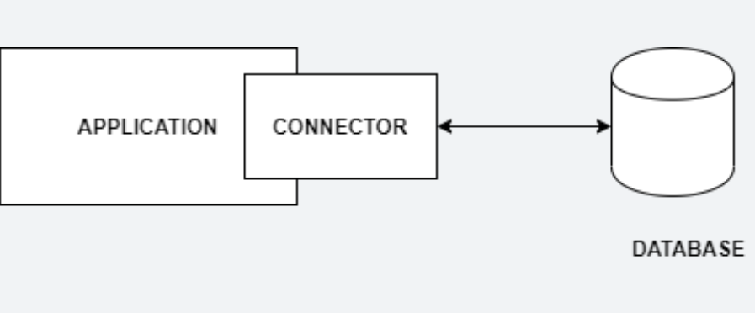
SQLITE3 PYTHON MODULE
Python SQLite3 module is used to integrate the SQLite database with Python. It is a standardized Python DBI API 2.0 and provides a straightforward and simple-to-use interface for interacting with SQLite databases. SQLite does not require a server to run. SQLite database is joined with the application that accesses the database. SQLite databases read and write directly from the database files stored on disk and applications interact with that SQLite database. Visual representation:

Slide 5
TKINTER PYTHON GUI MODULE
Graphical User Interface(GUI) is a form of user interface which allows users to interact with computers through visual indicators using items such as icons, menus, windows, etc. It has advantages over the Command Line Interface(CLI) where users interact with computers by writing commands using keyboard only and whose usage is more difficult than GUI.
Tkinter is the inbuilt python module that is used to create GUI applications. It is one of the most commonly used modules for creating GUI applications in Python as it is simple and easy to work with. Tkinter is a useful tool for creating a wide variety of graphical user interfaces, including windows, dialog boxes, and custom widgets. It is particularly well-suited for building desktop applications and adding a GUI to command-line programs.

Slide 6
CODE STRUCTURE: CLASSES
BOOK CLASS
Create Book object
Title
(String)
ISBN
(Integer)
Author
(String)
Copies
(True/False)
Update to Bookmaster
STUDENT CLASS
Create Student object
Name
(String)
SRN
(String)
Card No.
(Integer)
No. of Books Borrowed
(Integer)
Update to Studentmaster
Classes
Methods
Parameters

Slide 7
CODE STRUCTURE: FLOWCHART
BOOKMASTER
STUDENTMASTER
ISSUER
Check data
Enter
Enter
RETURN
TITLE
ISBN
AUTHOR
AVAILABILITY
NAME
SRN
CARD NO.
NO. OF BOOKS
Check data
If data in return input
If data in issue input
NO
Message box display error
Extract
Extract
NO
TITLE
ISBN
NAME
SRN
Issuer/Return input
YES
YES
TITLE
ISBN
NAME
SRN
UPDATE BOOKMASTER AND STUDENTMASTER
Send data

Slide 8
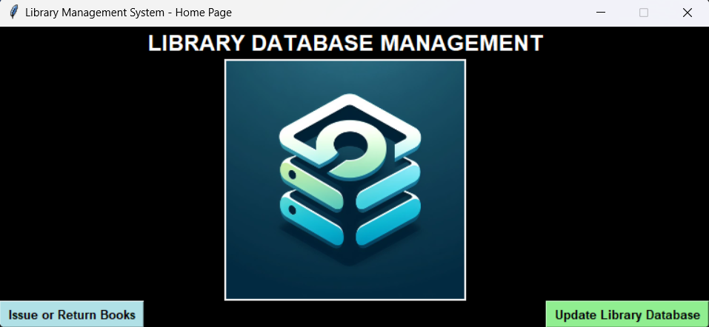
HOME PAGE
LOGO
Goes to issue/return module
Goes to update module

Slide 9
PSEUDO CODE (BOOK AND STUDENT CLASSES)
class book:
def __init__(self, title, ISBN, author, copies):
self.title = title
self.ISBN = ISBN
self.author = author
self.copies = 'Available’
# Includes book.update method which adds the book object to the Bookmaster database.
class student:
def __init__(self, name, SRN, cardNumber, count):
self.name = name
self.SRN = SRN
self.cardNumber = cardNumber
self.count = 0
# Includes student.update method which adds the student object to the Bookmaster database.

Slide 10
PSEUDO CODE (DATABASE CREATION)
command = '''CREATE TABLE <Table_Name> (
<Row_1_Name> <datatype>,
<Row_2_Name> <datatype>,
<Row_3_Name> <datatype>,
<Row_4_Name> <datatype>
)'''
std.execute(command)

Slide 11
PSEUDO CODE (UPDATING BKK, STD, ISS, RET MODULES)
def update(self):
x = sqlite3.connect(<database_file>)
y = x.cursor()
y.execute(‘’’INSERT INTO <database_name>’’’)
messagebox.showinfo(message=‘Database updated.')
x.commit()
x.close()

Slide 12
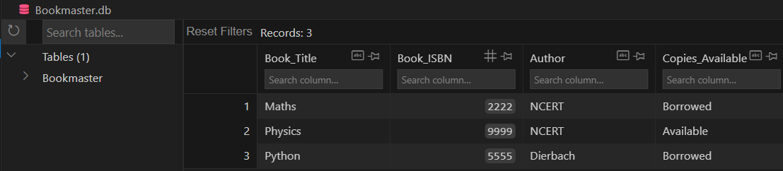
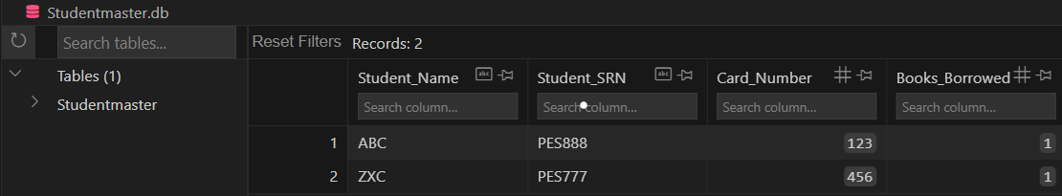
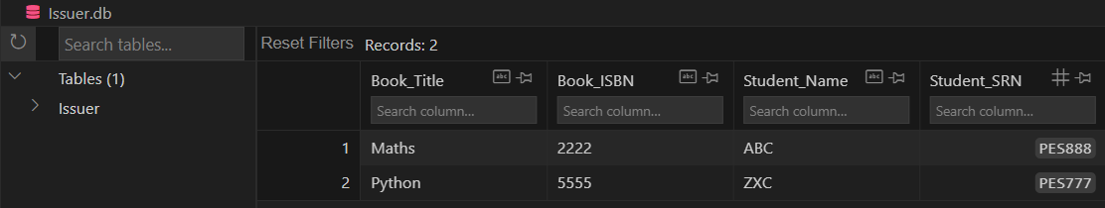
OUTPUT AFTER ISSUE
Here Maths and Python books were issued to ABC and ZXC respectively.

Slide 13
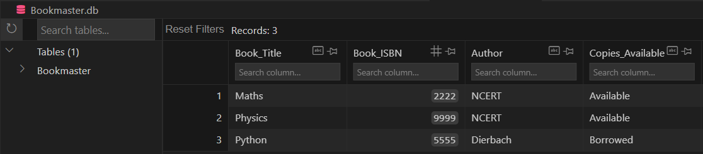
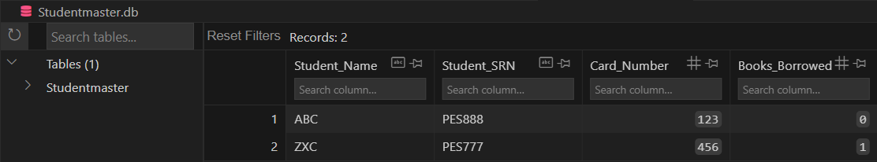
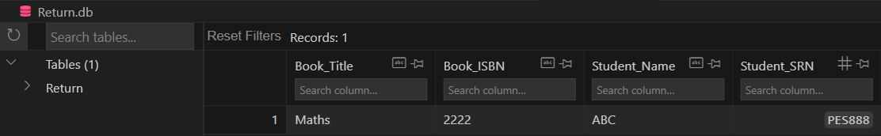
OUTPUT AFTER RETURN
Here Maths book was returned.

Slide 14

REFERNCES
Geeks for geeks python tutorials: Python Tutorial | Learn Python Programming (geeksforgeeks.org)
Geeks for geeks SQL tutorials: SQL Tutorial (geeksforgeeks.org)

Slide 15



THANK YOU!
CREATED ON VISUAL STUDIO CODE

